Slide 1
Object Oriented Software Engineering (OOSE)
22CS017
Introduction to Software Testing

Slide 2
Index
Software Testing
Types of Software Testing
Unit Testing
Practice Questions

Slide 3
Software Testing
Software Testing is a method to assess the functionality of the software program.
The process checks whether the actual software matches the expected requirements and ensures the software is bug-free.
The purpose of software testing is to identify the errors, faults, or missing requirements in contrast to actual requirements.
It mainly aims at measuring the specification, functionality, and performance of a software program or application.
Software testing can be divided into two steps:
Verification: It refers to the set of tasks that ensure that the software correctly implements a specific function. It means “Are we building the product right?”.
Validation: It refers to a different set of tasks that ensure that the software that has been built is traceable to customer requirements. It means “Are we building the right product?”.

Slide 4
Importance of Software Testing:
Defects can be identified early: Software testing is important because if there are any bugs they can be identified early and can be fixed before the delivery of the software.
Improves quality of software: Software Testing uncovers the defects in the software and fixing them improves the quality of the software.
Increased customer satisfaction: Software testing ensures reliability, security, and high performance which results in saving time, costs, and customer satisfaction.
Helps with scalability: Software testing type non-functional testing helps to identify the scalability issues and the point where an application might stop working.
Saves time and money: After the application is launched it will be very difficult to trace and resolve the issues, as performing this activity will incur more costs and time. Thus, it is better to conduct software testing at regular intervals during software development.

Slide 5
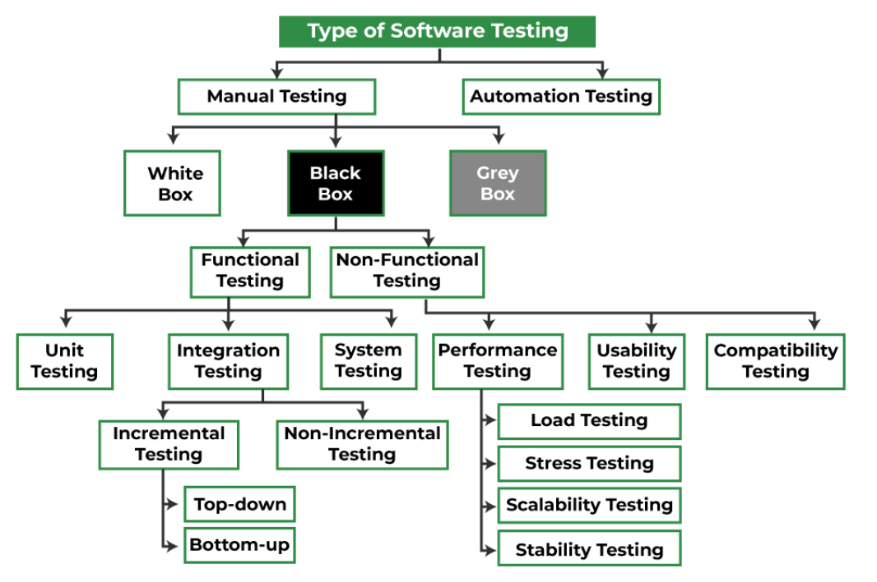
Different Types Of Software Testing

Slide 6
Black box vs Whit box Testing
Black Box Testing
is a software testing method in which the internal structure/design/implementation of the item being tested is not known to the tester. Only the external design and structure are tested.
White Box Testing
is a software testing method in which the internal structure/design/implementation of the item being tested is known to the tester. Implementation and impact of the code are tested.
Black box testing is a testing technique in which the internal workings of the software are not known to the tester. The tester only focuses on the input and output of the software.
Whereas, White box testing is a testing technique in which the tester has knowledge of the internal workings of the software, and can test individual code snippets, algorithms and methods.

Slide 7
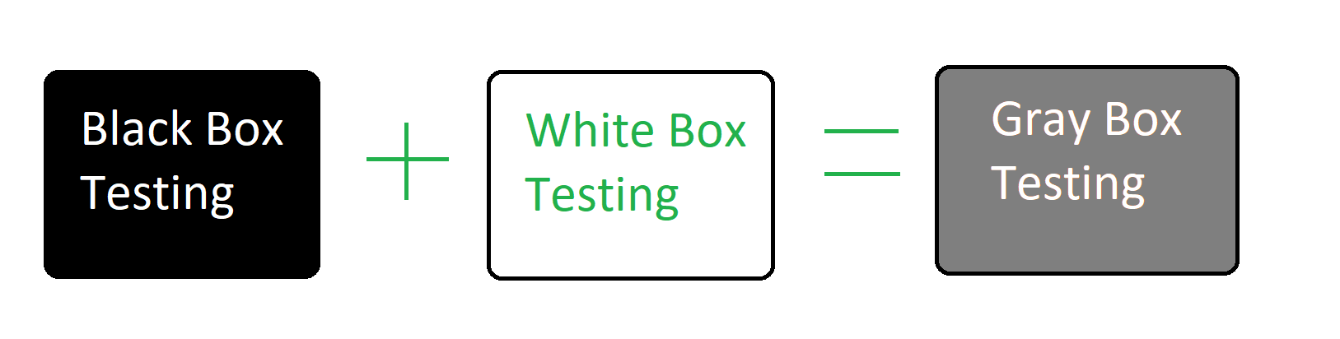
Gray Box Testing
Objectives of Gray Box Testing
To provide combined advantages of both black box testing and white box testing.
To combine the input of developers as well as testers.
To improve overall product quality.
To reduce the overhead of long process of functional and non-functional testing.
To provide enough free time to developers to fix defects.
To test from the user point of view rather than a designer point of view.

Slide 8
What is unit testing?
Unit testing is a software development process in which the smallest testable parts of an application, called units, are individually scrutinized for proper operation.
Software developers and sometimes QA staff complete unit tests during the development process. The main objective of unit testing is to isolate written code to test and determine if it works as intended.
Unit testing is an important step in the development process. If done correctly, unit tests can detect early flaws in code which may be more difficult to find in later testing stages.
Unit testing is a component of test-driven development (TDD), a pragmatic methodology that takes a meticulous approach to building a product by means of continual testing and revision.
This testing method is also the first level of software testing, which is performed before other testing methods such as integration testing.
Unit tests are typically isolated to ensure a unit does not rely on any external code or functions. Teams should perform unit tests frequently, either manually or more often automated.

Slide 9
How unit tests work
A unit test comprises three stages:
planning,
writing test cases and
performing the unit test itself.
In the first step, developers or QA professionals prepare and review the unit test. In the next step, they write test cases and scripts. In the third step the code is tested.
Test-driven development requires that developers first write failing unit tests. Then they write code and refactor the application until the test passes. TDD typically results in an explicit and predictable codebase.
Each test case is tested independently in an isolated environment to ensure a lack of dependencies in the code. The software developer should code criteria to verify each test case and use a testing framework to report any failed tests. Developers should not make a test for every line of code, as this may take up too much time. Developers should create tests focusing on code which could affect the behavior of the software being developed.
Unit testing involves only those characteristics that are vital to the performance of the unit being tested. This encourages developers to modify the source code without immediate concerns about how such changes might affect the functioning of other units or the program as a whole. Once all the units in a program work in the most efficient and error-free manner possible, teams can evaluate larger components of the program by means of integration testing.

Slide 11
Manual vs. automated unit testing
Developers can perform unit tests manually or automatically.
Those employing a manual method may have an instinctual document made detailing each step in the process; however, automated testing is the more common method for unit testing.
Automated approaches commonly use a testing framework to develop test cases. These frameworks are also set to flag and report any failed test cases while also providing a summary of test cases.

Slide 12
Unit testing advantages
There are many advantages to unit testing, including the following:
The earlier a problem is identified, the fewer compound errors occur.
Fixing problems early is usually cheaper than fixing them later in development.
Easier debugging processes.
Developers can quickly make changes to the codebase.
Developers can reuse code and migrate it to new projects.

Slide 13
Unit testing disadvantages
Tests will not uncover every bug.
Unit tests only test sets of data and its functionality -- it will not catch errors in integration.
More lines of test code may need to be written to test one line of code -- creating a potential time investment.
Developers may have to learn new skills to implement unit testing correctly; for example, having to learn how to use specific automated software tools.

Slide 14
Practice Questions
What are the types of Software testing?
What is difference between Unit testing and functional testing?
Give the real time scenario where unit testing is used?
Explain the difference between functional testing and non-functional testing.
What is the purpose of test cases and test scenarios?
What is a defect, and how do you report it effectively?
What is the difference between manual testing and automated testing?

Slide 15
Bibliography
https://www.geeksforgeeks.org/software-testing-basics/
https://www.techtarget.com/searchsoftwarequality/definition/unit-testing

